Slide 1
Center for Health & Homeland Security:
Who We Are
May 12, 2022
©2022, University of Maryland, Center for Health and Homeland Security

Slide 2
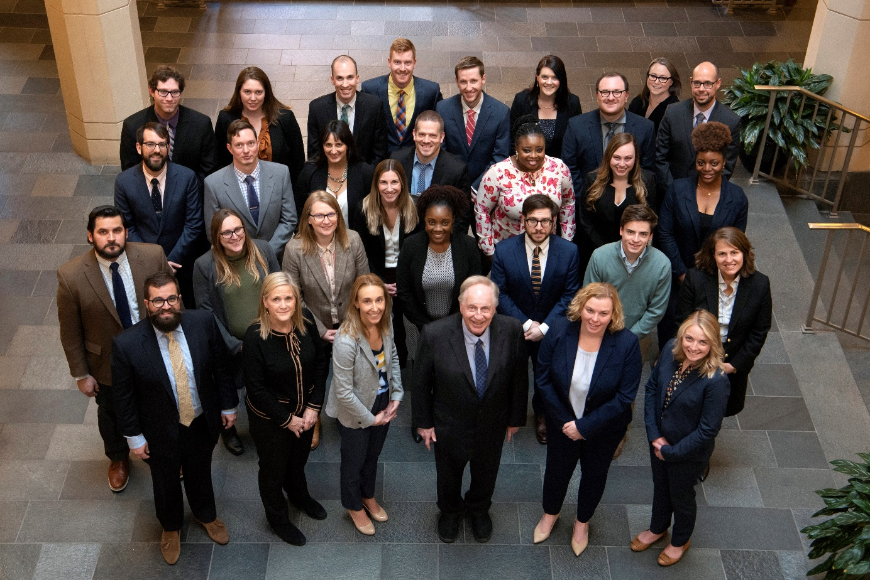
Our Team

Slide 3
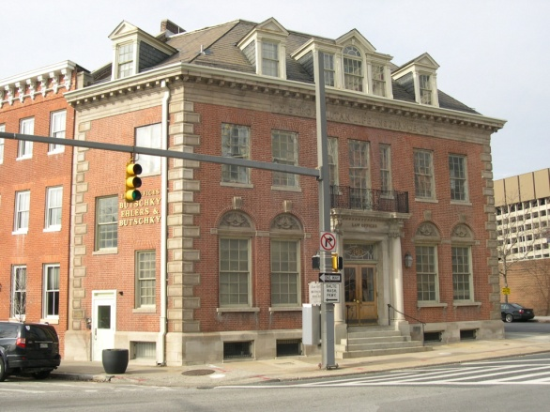
CHHS Offices
University of Maryland, Baltimore Campus:
School of Law
300 Russell Street
Universities at Shady Grove Campus
Approximately 1/2 of our staff members report to client sites

Slide 4
Academic Program Numbers
Cybersecurity and Crisis Management Certificate for J.D. Students
Since its inception in 2017, nearly 70 students have completed the certificate.
Approximately 35 students are currently pursuing the certificate.
Since 2015 CHHS has had over 75 externs
An additional 5 students are working as externs at CHHS this semester
CHHS teaches 25 courses in 4 degree programs, including JD, LLM, MSL and MPS

Slide 5
University of Maryland Carey Law Courses
Homeland Security & Law of Counterterrorism (3 credits)
International Law and Cybersecurity (3 credits)
Law & Policy of Emergency Management (3 credits)
Law & Policy of Emergency Public Health Response (3 credits)
Law & Policy of Cybersecurity (3 credits)
Cybercrime (2 credits)
National Security, Electronic Surveillance, and Bulk Data Collection (3 credits)
Opioid Epidemic: Law and Policy Seminar (3 credits)
MLaw: Law and Policy of Inner City/Urban Policing (3 credits)
Cyber Boot Camp: Tech for Lawyers (1 credit)
CHHS Externship (4 - 8 credits)

Slide 6
Spring 2022 Carey Law Courses
Cybercrime (17 students)
Homeland Security & the Law of Counterterrorism (18 students)
Law & Policy of Cybersecurity (10 students)
Law & Policy of Emergency Public Health Response (8 students)

Slide 7
Master of Science in Law (MSL) Program
Residential
Before transitioning online, 18 students completed their residential MSL in cyber and 15 completed their MSL in crisis management.
CHHS staff continued to teach: Introduction to U.S. Law and the Legal System, Legal Methods, Ethics, and Public Health Law residentially until all tracks moved online.
Online
The first cadre of online cyber students completed the program in Spring 2018; the first group of crisis management students completed the program in Fall 2018.
Now, over 70 students have completed the Cybersecurity track and nearly 50 have completed the Crisis Management track.
In addition to teaching all of the specialty courses in the Cybersecurity and Crisis Management tracks, CHHS staff continue to teach Introduction to U.S. Law and the Legal System, Legal Methods, and Ethics for all tracks, as well as Public Health Law for the Health track.

Slide 8
Master of Professional Studies (MPS) in Public Safety Leadership and Administration
The University of Maryland College Park Office of Extended Studies, in partnership with Maryland Carey Law, offers a graduate program in Public Safety Leadership & Administration. As part of this program, CHHS developed and teaches two courses each year.
Constitutional Law & Public Safety (3 credits)
Civil Legal Issues in Policing (3 credits)

Slide 9
CHHS Clients
Anne Arundel County Office of Emergency Management
Baltimore City Health Department
Baltimore City Department of Transportation
Baltimore City Office of Emergency Management
Baltimore Urban Housing Authority
Charles County Office of Emergency Management
City of Annapolis Office of Emergency Management
DC Homeland Security and Emergency Management Agency
Eastern Shore Communications Alliance
Frederick County Office of Emergency Management
Harford County Office of Emergency Management
Hospital Coalitions
Howard County Department of Health
Howard County Fire Department
Howard County Office of Emergency Management
Johns Hopkins Hospital
KeyW Corporation
Maryland Community Colleges
Maryland Department of Commerce
Maryland Department of Health
Maryland Department of Natural Resources
Maryland Department of Emergency Management
Maryland Department of the Environment
Maryland Department of Transportation
Maryland Emergency Management Agency
Maryland Emergency Response System
Maryland Governor’s Office of Homeland Security
Maryland Healthcare Coalitions
Maryland School for the Deaf
Montgomery County Health Department
Montgomery County Office of Homeland Security and Emergency Management
Montgomery County Transit
National Academy of Sciences, Transportation Research Board
National Security Agency
Prince George’s County Health Department
Prince George’s County Office of Emergency Management
Project on National Security Reform
Talbot County Office of Emergency Management
The Middle Atlantic Regional Center of Excellence for Biodefense and Emerging Infectious Diseases Research (MARCE)
The National Capital Region (NCR) Urban Area (MD, VA, DC)
U.S. Department of Agriculture
U.S. Department of Homeland Security (DHS) Federal Emergency Management Agency (FEMA)
U.S. Department of State
UMS Chancellor’s Office
University of Georgia, School of Law
University of Maryland, Baltimore
Washington Suburban Sanitary Commission

Slide 10
Cybersecurity Law & Policy Program Highlights
Maryland Cybersecurity Council
Appointment by Maryland Attorney General
Chair of Critical Infrastructure Subcommittee
Member of Legislative Subcommittee. Provide expert advice and recommendations to State Senators on legislative initiatives.
Co-chaired 2021 Ad Hoc Subcommittee and drafted report on State and Local Cybersecurity in Maryland
US Cyber Command Academic Engagement Network
Maryland Carey Law is the only law school accepted into the Network
Opportunities for academic and practical engagement (e.g. guest speakers, mentorships, internships and new grad jobs)
Invitation to annual US Cyber Command Legal Conference
Testimony - Provide testimony at federal and state level on cybersecurity matters
Scholarship Opportunities
Maryland Cyber Scholars Program – financial assistance in return for public service commitment
International Association of Privacy Professionals (IAPP) Westin Scholar Award – annual award to one Carey Law student for excellence in cybersecurity and data privacy law
Speakers at national conferences (e.g. National Conference of State Legislatures; National Initiative for Cybersecurity Education; National Homeland Security Conference)
Student Cyber Law and Data Privacy Association – offers speakers, networking, job search assistance
Annual (free) invitation for Maryland Carey Law to attend Incident Response Forum – top legal conference on incident response

Slide 11
Cybersecurity Law & Policy Academics and Client Work
Academics
Cyber Law courses developed and taught for JD, LLM, and MSL programs
Law and Policy of Cybersecurity; Cybercrime; International Cybersecurity; NSA and 4th Amendment; Tech for Lawyers: Cyber Boot Camp.
JD Certificate in Cybersecurity and Crisis Management Law (Maryland Higher Education Commission approved)
Dual Degree MOU and credit transfer agreement with UMBC providing law and technology degrees
JD cyber graduates go to work in government and private sector (e.g. NSA Legal Honors Program, FCC, Deloitte, Under Armour)
Client Project Highlights
Cyber Incident Response Planning for Montgomery, Prince George’s, and Anne Arundel Counties
National Security Agency: Developed a cyber law curriculum used by current and future cybersecurity professionals

Slide 12
Public Health Legal Work
CHHS researched and wrote “Transit and Emerging Infectious Disease Outbreaks: Legal Issues” for the National Academies of Science, Transportation Research Board. The legal digest of fifty states’ transit and public health laws focuses on specific transit response measures during an Emerging Infectious Disease outbreak.
Updated the Maryland Department of Health’s Public Health Emergency Legal Preparedness Handbook, which CHHS originally wrote for MDH in 2010.
In collaboration with the Association of State and Territorial Health Officials (ASTHO), CHHS developed two toolkits addressing the topics of emergency drug shortages and issues related to altered standards of care during emergencies.

Slide 13
COVID-19 Public Health Planning and Response
CHHS assisted an International Airport in the U.S. as it drafted initial response policies and procedures in March/April 2020 for novel legal questions posed by COVID and travel.
Participated in Maryland Attorney General Brian Frosh's Covid-19 Access to Justice Task Force to ensure Maryland residents were able to access needed services during the pandemic.
Spoke to various organizations, including the Maryland State Bar Association, attorney work groups, county commerce organizations, and others about short- and long-term implications of the virus, stay-at-home orders, quarantine and isolation orders, vaccine mandates, and mask requirements, among other issues.
Supported the Washington Suburban Sanitary Commission’s (WSSC) COVID response.
Staff wrote articles on novel law and policy issues, including Governors’ powers and comparing states’ emergency declarations, as well as COVID’s impact mental health on emergency management and response workers.
Hotwash, CHHS’ podcast, focused on the COVID-19 pandemic response nationally and internationally.

Slide 14
COVID-19 Public Health Planning and Response
CHHS staff assisted local health departments with initial response, from PPE allocation and distribution to testing and vaccine site set up and implementation, including in Baltimore City, Montgomery County, and Prince George’s County.
Eight of these CHHS staff were chosen as UMB Champions of Excellence: Hassan Sheikh, Jihane Ambrose, Joseph Corona, Samantha Durbin, Patrick Fleming, Ian Hamilton, Netta Squires, and Kimberly Stinchcomb.
CHHS Staff continue to support longer-term response and recovery at the local and agency level.

Slide 15
Centers for Medicare & Medicaid Services (CMS) Emergency Preparedness Rule and Nursing Homes
In 2019, CHHS conducted a pro bono pilot half-day training and tabletop exercise for 7 area facilities and providers; additional community training planned for 2020 was canceled due to COVID.
CHHS was awarded money from the Maryland Legislature to continue this important work in 2021 and beyond.
Currently, CHHS is researching and writing a best practices white paper and legal and policy trends white paper on CMS Rule changes and COVID that facilities.
More training/tabletop exercises are being planned for 2022-2023, incorporating legal and policy changes to the CMS Emergency Preparedness Rule.

Slide 16
Recovery Program Highlights
Led the recovery efforts for the 2016 & 2018 Ellicott City Floods
Developed Montgomery County’s Pre-disaster Recovery Plan (2019)
Developed Prince George’s County Emergency Response & Recovery Plan (2019)
Provided recovery expertise for trainings to Federal Emergency Management Agency (FEMA)
Facilitated Recovery from COVID-19, including developing After Action Reports, for the following clients:
Montgomery County
Anne Arundel County
Prince George’s County

Slide 17
Combating Food Insecurity
CHHS staffed the Montgomery County Food Security Task Force, guiding the response to the COVID-19 driven spike in food insecurity.
CHHS staff helped draft Montgomery County’s Food Insecurity Response Strategy, guiding the allocation of over $30M in public and private funds dedicated easing food insecurity and stabilizing the local food system.

Slide 18
Emergency Declaration for Opioid Overdose Deaths
CHHS assisted the Maryland Department of Emergency Management in researching and writing a comprehensive report on the State’s actions to reduce opioid deaths during the declared state of emergency.
CHHS staffer, Birch Barron, worked as the Chief of Staff for the Governor’s Opioid Operational Command Center (OOCC); CHHS staffer, Christine Gentry, was the Planning Chief for the OOCC.

Slide 19
Hospital Preparedness and Medical Surge Planning
CHHS conducted full scale exercises for the Maryland Region V Healthcare Coalition, consisting of more than 15 hospitals and health departments in Montgomery, Calvert and Prince George’s Counties.
CHHS assisted the Maryland Department of Health’s Maryland Region III Health and Medical Task Force in creating an Alternate Care Site (ACS) in Baltimore, including a legal handbook, standard operating procedures, plans and policies for the site, as well as developing legislation for the Task Force to propose to the Maryland General Assembly.

Slide 20
Senior Crisis Management Trainings for Foreign Country Delegations Department of State, Office of Anti-Terrorism Assistance (ATA)
Seminar Content: Responding to crises, including terrorist events, through mitigation, planning, response, and recovery.
Target Audience: Foreign government officials, including senior law enforcement officials.
Since February 2011, CHHS teams have traveled to Colombia, Jordan, Pakistan, Tanzania, Turkey, Cyprus, Brazil, and Ecuador to conduct in-country site assessments.
Seminars conducted: Bosnia, Brazil, Colombia, Cyprus, Ecuador, Egypt, India, Iraq (Kurdistan Regional Government), Iraq (Federal Government of Iraq), Jordan, Lebanon, Libya, Malaysia, Nigeria, Pakistan, Philippines, Indonesia, Tanzania, Tunisia, Turkey, Uganda, Yemen, and Kenya.

Slide 21
Foreign Terrorism Legal Training
Seminar Content: U.S. best practices on surveillance, detainment, prosecution, and deterrence of terrorism
Target Audience: Foreign judges and prosecutors
Delegations from the Philippines and Lebanon traveled to DC through a contract between CHHS and the U.S. Department of State for high-level training.
CHHS Director lead the training supported by CHHS senior staff and subject matter experts from around the country.
The training included substantive briefings by nationally recognized judges, prosecutors, and defense attorneys, as well as visits to the Department of Justice, FBI, United States Supreme Court, and the U.S. District Courts for Maryland and the District of Columbia.

Slide 22
Conferences
Presenter, “Leveraging Emergency Management for Cybersecurity Preparedness,” National Homeland Security Conference, Las Vegas, NV, August 2021
Presenter, “Integrating Cybersecurity Into Emergency Management Programs” FEMA Emergency Management Higher Education Symposium, June 2020
Presenter, ”Integrating Law and Policy Into Cybersecurity Education, NICE Conference, Phoenix, AZ November 2019
Presenter, “Best Practices in Cyber Preparedness and Response, National Hurricane Preparedness Conference, New Orleans, LA, April 2019
Presenter, Law and Policy of Cybersecurity Curriculum, NSA Cybersecurity Curriculum Expo IV, April, 2019
Presenter, “A, B, C, Disaster: Increasing Community Resilience through Enhanced Relationships with Early Childcare Providers & Educators,” Preparedness Summit, March 26-29 2019, St. Louis, Missouri.
Presenter, Law and Policy of Cybersecurity Curriculum, NSA Cybersecurity Curriculum Expo III, November, 2018.
Presenter, “Building Partnerships for Public Health: Collaboration in Emergency Preparedness,” Network for Public Health Law Conference, October 4-6 2018, Phoenix, Arizona.
Presenter, “It Takes a Village: The Building Partnerships for the Evolving Role of Emergency Management,” International Association of Emergency Managers Conference, October 19-24, 2018, Grand Rapids, Michigan.

Slide 23
Conferences
Panelist, “Internet of Things, Autonomous Cars, and Drones” CyberMaryland, October 12, 2017.
Guest Lecturer, “Cybersecurity and Terrorism,” Georgetown University Executive Masters of Professional Studies in Emergency and Disaster Management, September, 18, 2017.
Presenter, 2017 National Homeland Security Conference, June 6, 2017.
Presenter, 2017 Maryland Emergency Managers Association Conference, May 30, 2017.
Moderator for Panel on “The State of Cyberlaw: Security and Privacy - Surveillance and Law Enforcement in the Digital Age,” University of Maryland Francis King Carey School of Law and the Maryland Law Review, February 10, 2017.
Webinar, Emergency Preparedness Against Infectious Diseases on Public Transit, National Academies of Science, Transportation Research Board, August 14, 2018 (over 400 online attendees).
Presenter, Law and Policy of Cybersecurity Curriculum, NSA Cybersecurity Curriculum Expo II, April, 2018.
Speaker, “Maryland City County and State Organizations Bring Cyber Home,” Rockville Economic Development Inc, Maryland Department of Commerce, TEDCO, March 16, 2018.
Presenter, Law and Policy of Cybersecurity Curriculum, NSA Cybersecurity Curriculum Expo I, November, 2017.

Slide 24
124 Maryland Law Alumni at CHHS
Marita Mike, 1999H | David Bohannon, 2005 | Sean Kates, 2007 | Kristen Skogsberg, 2008 | Elizabeth Webster, 2010 | Joey Kroart, 2014 | Frank Maldarelli, 2020
Kate Christensen, 2002 | David Brummett, 2005 | Cezar Lopez, 2007 | Raymond Shin, 2008 | Avery Blank, 2011 | Christine Gentry, 2014 | Joe White, 2020
Erin Hahn, 2002 | Ellen Cornelius Ericson, 2005 | David McDonough, 2007 | Mathew Swinburne, 2008 | Bryan Hull, 2011 | Taylor Kasky, 2015 | Hanna Leonard, 2021
Krista Horochena, 2002 | Matthew Fuchs, 2005 | Amy Major, 2007 | Ben Alpert, 2009 | Rebecca Mansbach, 2011 | Jason Rubinistein, 2015 | Chang Won Kang, 2021
Daniel McBride, 2002 | Ulka Ghanta, 2005 | Jennifer Martin, 2007 | Adam Coleman, 2009 | Keti Shea, 2011 | Michael Tennison, 2015
Lori Romer Stone, 2002 | Christina Hermann, 2005 | David Mandell, 2007 | Dan Goodman, 2009 | Nisha Sherry, 2011 | Sean Harding, 2016
Karyn Bergmann, 2003 | Jonathan Minkove, 2005 | Daniel Orlaskey, 2007 | John Katz, 2009 | George Waddington, 2011 | Tyler Hoblitzell, 2016
Chris Gozdor, 2003 | Catherine Napjus, 2005 | Nicole Chapple, 2007 | Talley Kovacs, 2009 | Michael Ulrich, 2011 | Margaret Glover, 2016
Brent McKee, 2003 | Deborah Silver, 2005 | Karla Schaffer, 2007 | David Myers, 2009 | Brandy Bruyere, 2012 | Allison Kronback, 2016
Mike Beland, 2004 | Brooke Courtney, 2006 | Arianne Spaccarelli, 2007 | Paris Nourmohammadi, 2009 | Marissa Clark, 2012 | Chris Smith, 2016
AJ Bellido De Luna, 2004 | Clark Lee, 2006 | Michael Stallings, 2007 | John O’Neil, 2009 | Kasia Fertala, 2012 | Jules Szanton, 2016
Rob Burriesci, 2004 | Saj Popat, 2006 | Megan Timmins, 2007 | Erin Podolny, 2009 | Gregory Sunshine, 2012 | Amy Rappole, 2016
Sabrina Chase, 2004 | Benjamin Pulz, 2006 | Anthony Villa, 2007 | Jennifer Shahabuddin, 2009 | Sheena Tomar, 2012 | Jonathan Lim , 2017
Matt Gallagher, 2004 | Rebecca Shore-Suslowitz, 2006 | Jillian Williams, 2007 | Peter Suh, 2009 | Meredith Leeson, 2013 | Tyler Babich, 2018
Jeff Gilberg, 2004 | Michael Vesely, 2006 | Aileen Xenakis, 2007 | Meghan Butasek, 2010 | Max Romanik, 2013 | Patrick Fleming, 2018
Alyssa Johnson, 2004 | Adrian Wilairat, 2006 | Colleen Clary, 2008 | Peter Fox, 2010 | Ben Yelin, 2013 | Hassan Sheikh, 2018
Charles Madden, 2004 | Markus Rauschecker, 2006 | Jessica George, 2008 | Jessica Hurst, 2010 | Rachel Almaraz, 2013 | Ariel Neumann, 2019
Alexandra Podolny, 2004 | Robin Clark, 2007 | Trudy Henson, 2008 | Jung Lee, 2010 | Margaret Davis, 2013 | Michael Block, 2020
Heather Shaivitz, 2004 | Michael Craven, 2007 | Atresha Karra, 2008 | Max Tondro, 2010 | Sonia Siddiqui, 2013 | Zachary Liebman, 2020
Jodi Stern, 2004 | Sandy Dornsife, 2007 | Brigid Ryan, 2008 | Christopher Webster, 2010 | Katherine Cooper, 2014 | Peter McCullough, 2020

